Slide 1

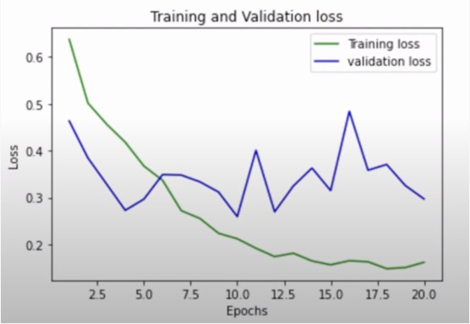
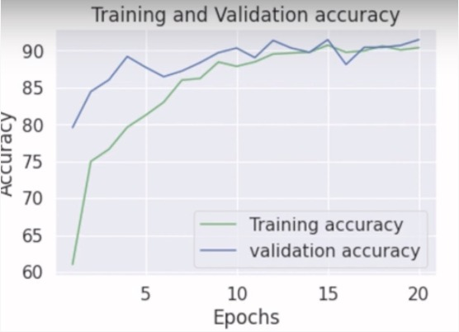
DEEPFAKE VIDEO DETECTION USING DEEP LEARNING Lavaneeth Reddy, Siddhartha Talasila
ABSTRACT
This is a current real-world problem where the objective is to accurately determine if a video contains deepfake content. Research papers have shown that Human behaviors such as the natural blinking patten of the eye is hardly mimicable by deepfake videos. Theoretical models have been discussed namely involving a mixture of LRCN and LSTM.
DATA
it is a huge dataset which consists of videos with more the 700 videos. Of 2 classes normal and fake video.
METHODOLOGY
The first pretrained facial detection model chosen is MTCNN and Inception Reset models. Using Face net in python, the face feature vector were calculated for all the face in each video. The distance from each face to the centroid for its video was then calculated and acted as means of discrimination.
RESULT
we see that the model performed poorly for a binary classification problem. The clusters are continuous and there is a lack of separation of the output. The small rage of 0.46 to 0.56 cannot be used to distinctly. Although a face detection pipeline was successfully created. it was not effective
CONCLUSION
The rest of the videos follows a somewhat normal distribution. Many combinations of CNNs and LSTM should be tried out and further tuned to solve this problem.
REFERENCES
[1] Mulla, Rob. (2020) FaceForensicst+ Baseline (dib & noKapele.cominternet). [online](2020)
[2] Timesier (2020) Facial recognition model in pytorch. (online] Kaggle.com. [2020]

